Slide 1
Azure Vision Chad Michel @chadmichel cmichel@dontpaniclabs.com

Slide 2

Chad Michel
UNL graduate (Computer Engineering & CS)
Software Architect
Adjunct at UNL (Software Engineering)
Beehive & DPL
Lifelong Nebraskan
Wife and 2 kids

Slide 3
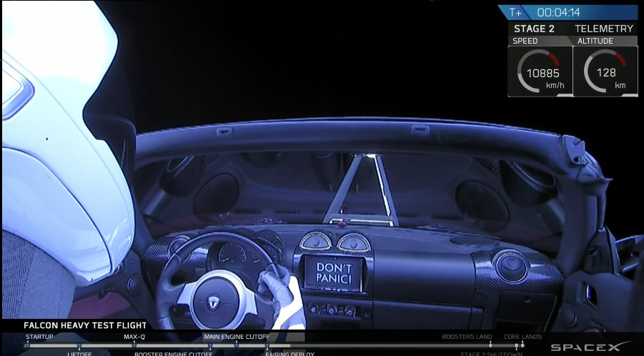


Slide 4
DPL Projects
Lots of projects come through the door
Continue to grow in complexity

Slide 5
Forms over data
Web
System
DB

Slide 6
Web App + mobile App + System
Web
Mobile
System
DB

Slide 7
Web App + mobile App + System + Cloud
Web
Mobile
System
DB

Slide 8
Web App + mobile App + Systems + Cloud
Web
Mobile
Web
System
System
DB
DB

Slide 9
Web App + mobile App + Systems + Clouds
Web
Mobile
Web
System
System
DB
DB

Slide 10
Web App + mobile App + Systems + Clouds + IoT
Web
Mobile
Web
System
System
DB
DB

Slide 11
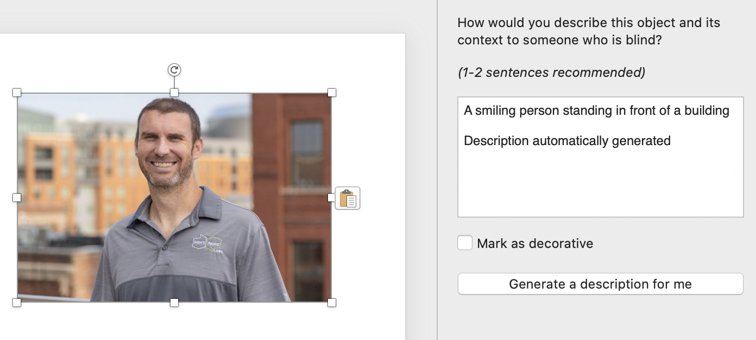
Rich capabilities

Slide 12
I am not a computer vision expert
I can’t tell you about the algorithms
I can’t explain which solution is better
I am not going to touch on ethical issues

Slide 13
Who didn’t make the coffee? Azure Vision
Chad Michel

Slide 14
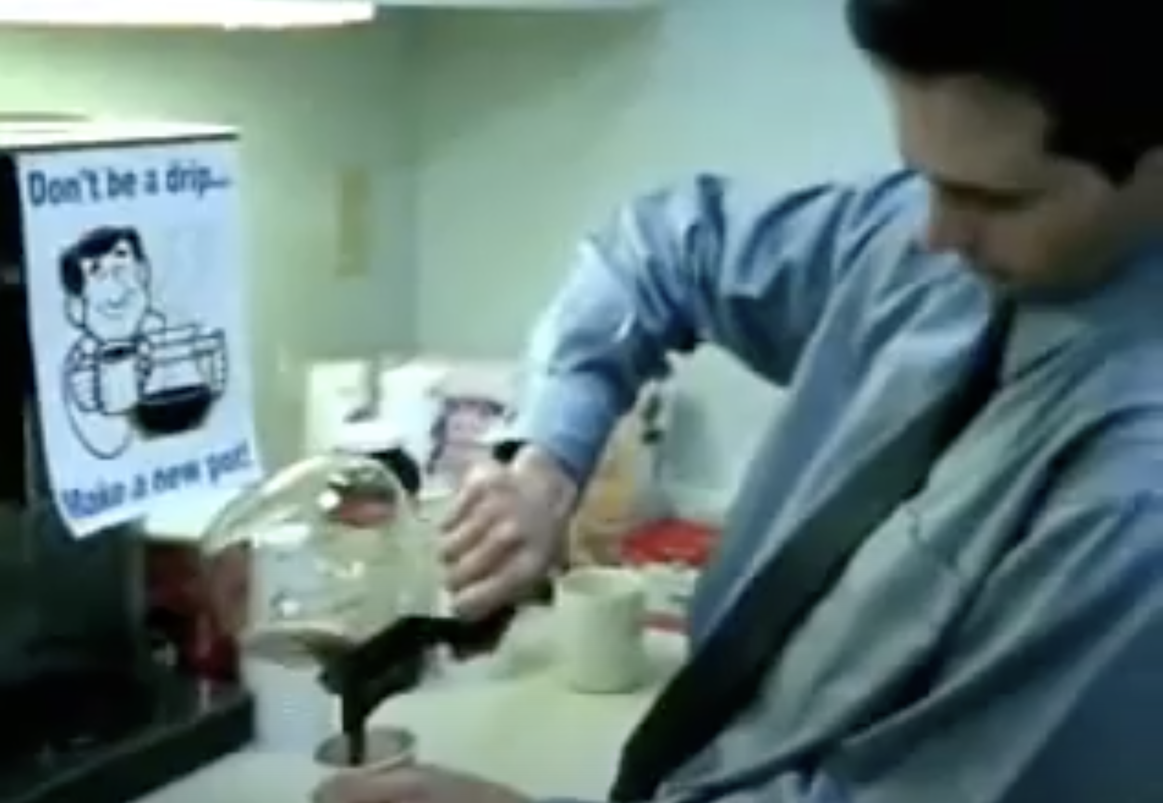

Slide 15


Slide 16
Problem: Coffee pots are often empty.
Solution: More technology than is appropriate.

Slide 17
Nothing fancy
Coffee Log
10:20am Bill​
10:21am Doug​
10:30am Chad​
10:45am Hadley

Slide 18
Options
Realize not worth the effort
Just a camera we can check
Software that will tell me who was last at the coffee pot

Slide 19
Options
Realize not worth the effort
Just a camera we can check
Software that will tell me who was last at the coffee pot

Slide 20
How do we determine which DPL face is in an image?

Slide 21


Options
OpenCV
Amazon
Rekognition
Azure
Vision

Slide 22
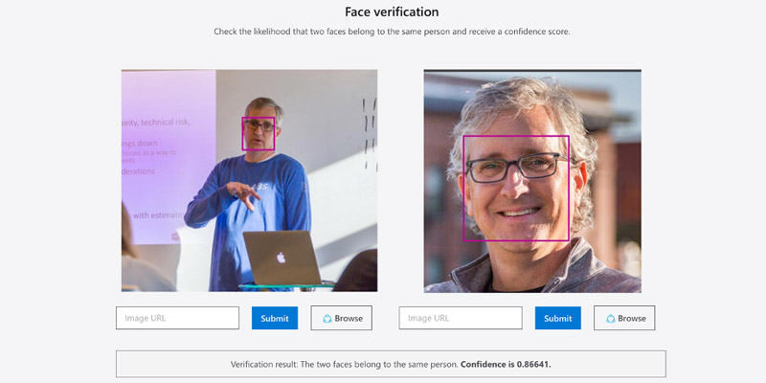
Microsoft Demo Site
https://azure.microsoft.com/en-us/services/cognitive-services/face/#demo

Slide 23
Setup
nuget: https://www.nuget.org/packages/Microsoft.Azure.CognitiveServices.Vision.Face
Azure API Key (Azure Face)
.NET Console App

Slide 24
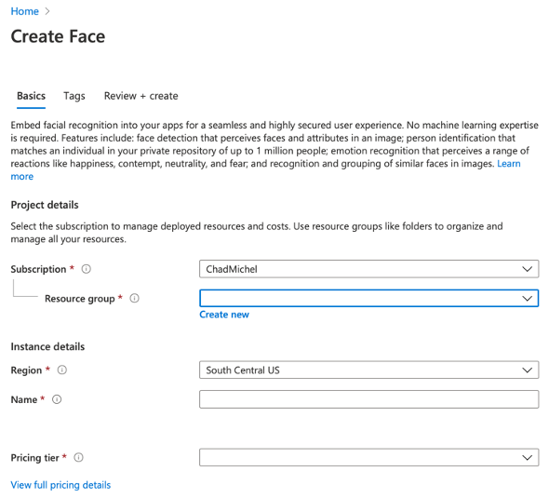

Slide 25
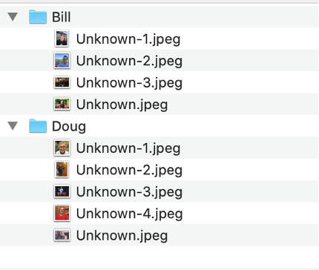

Train for DPL Employees

Slide 26
Training
Create PersonGroup
Create PersonGroupPerson
Add image to PersonGroupPerson
Train PersonGroup

Slide 27
Create PersonGroup
await Client.PersonGroup.CreateAsync(“DPL”, ”DPL”);

Slide 28
Create PersonGroupPerson
var person = await Client.PersonGroupPerson.CreateAsync( PersonGroupId.ToString(), “Doug”, “Doug”);

Slide 29
Add image to PersonGroupPerson
await using var stream = personImage.OpenRead(); await Client.PersonGroupPerson.AddFaceFromStreamAsync(PersonGroupId, person.PersonId, stream);

Slide 30
Train PersonGroup
await Client.PersonGroup.TrainAsync(PersonGroupId); while(true) { var trainingStatus = await Client.PersonGroup.GetTrainingStatusAsync(PersonGroupId); if (trainingStatus.Status != TrainingStatusType.Running) { break; } await Task.Delay(5000); // wait 5 seconds }

Slide 31
Find Employee in image
Detect Face
Identity person
Compare with known people

Slide 32
1. Detect Face
var detectedFaces = await Client.Face.DetectWithStreamAsync(stream);

Slide 33
2. Identify person
var found = await Client.Face.IdentifyAsync( detectedFaces.Select(df => df.FaceId).ToList(), PersonGroupId);

Slide 34
3. Compare with known people
var foundPersonName = PersonLookup[foundPerson.Candidates.First().PersonId];

Slide 35
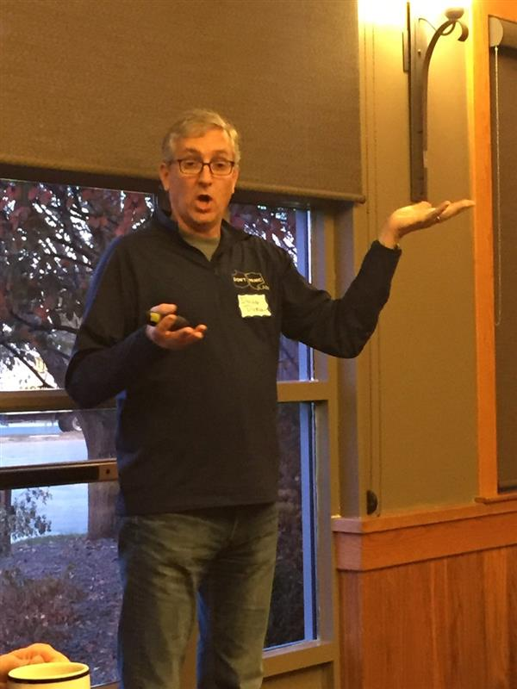

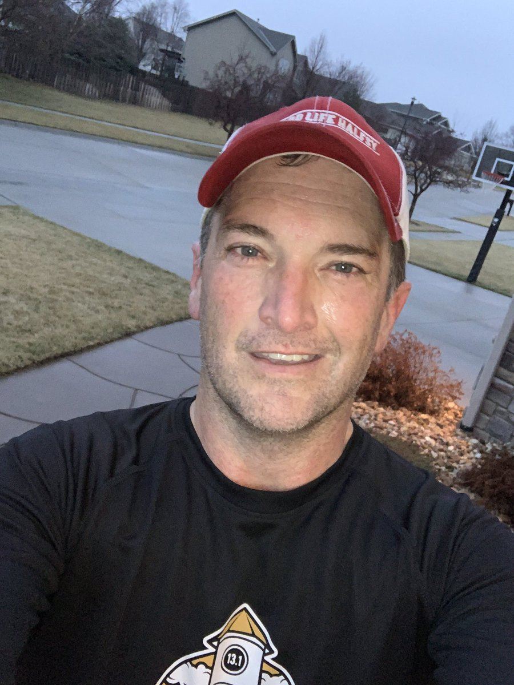

Doug
Bill

Slide 36

Doug
Bill

Slide 37



Slide 38
Other interesting things…

Slide 39
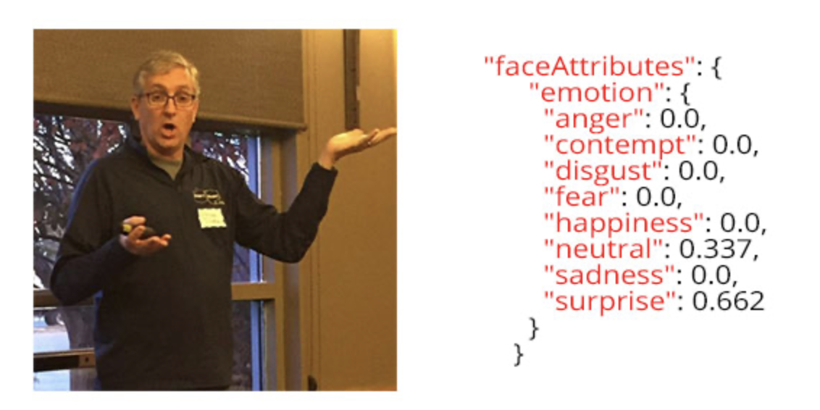
Emotion

Slide 40
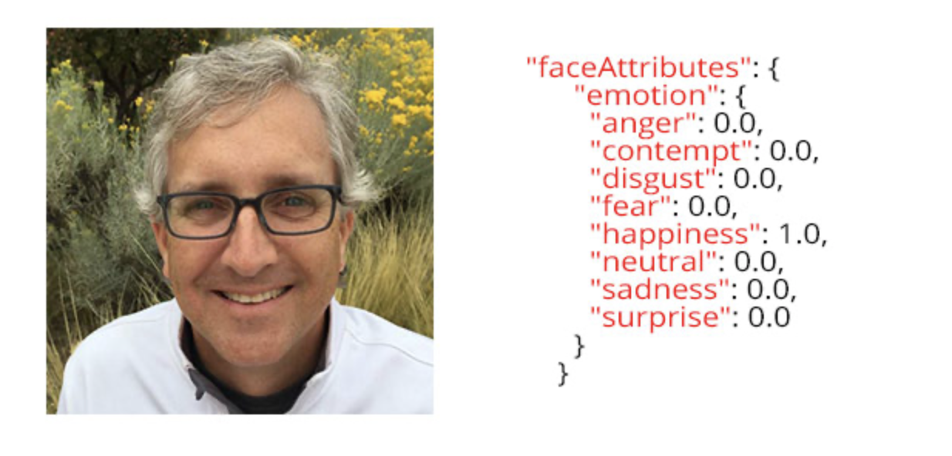
Emotion

Slide 41
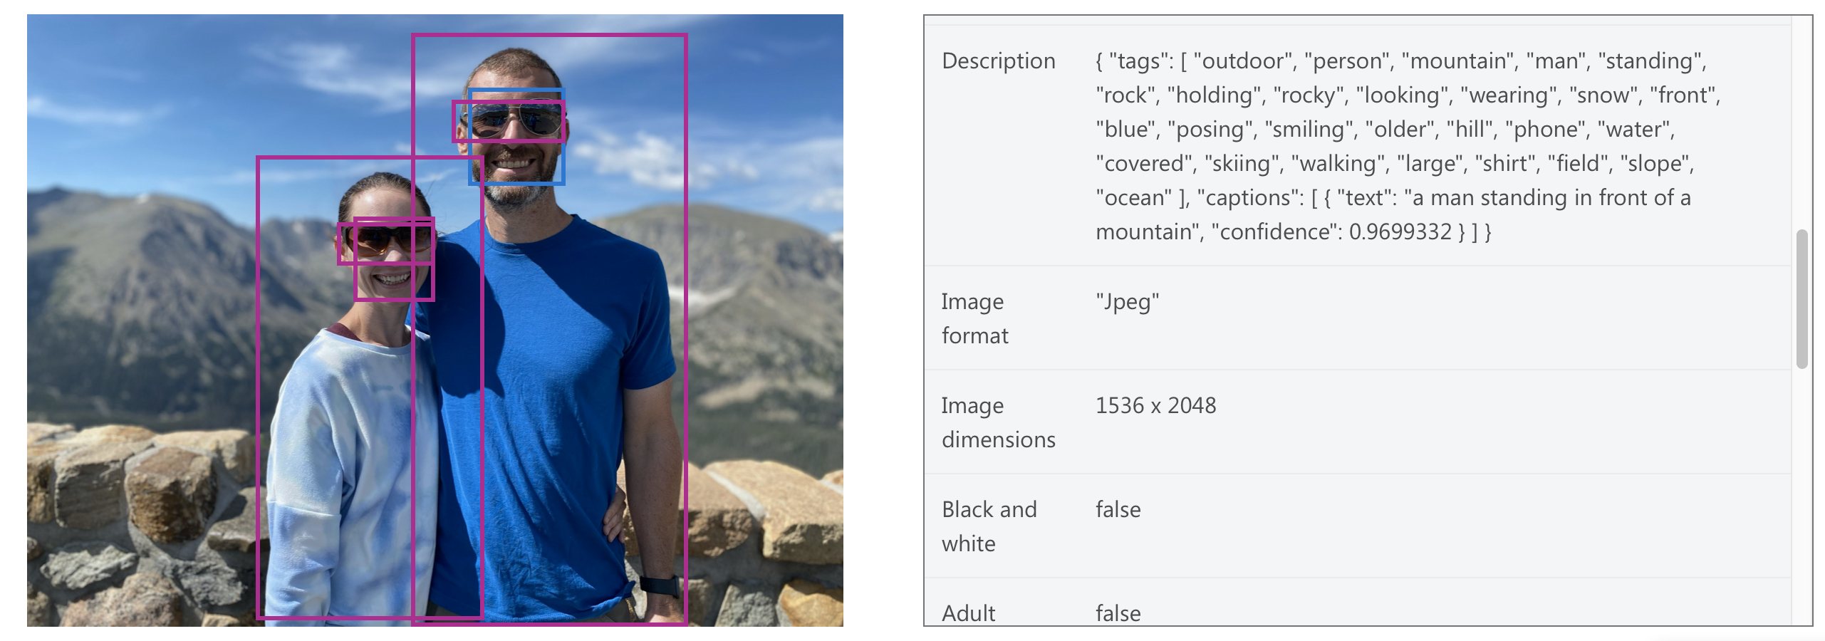
Get text description of a picture

Slide 42
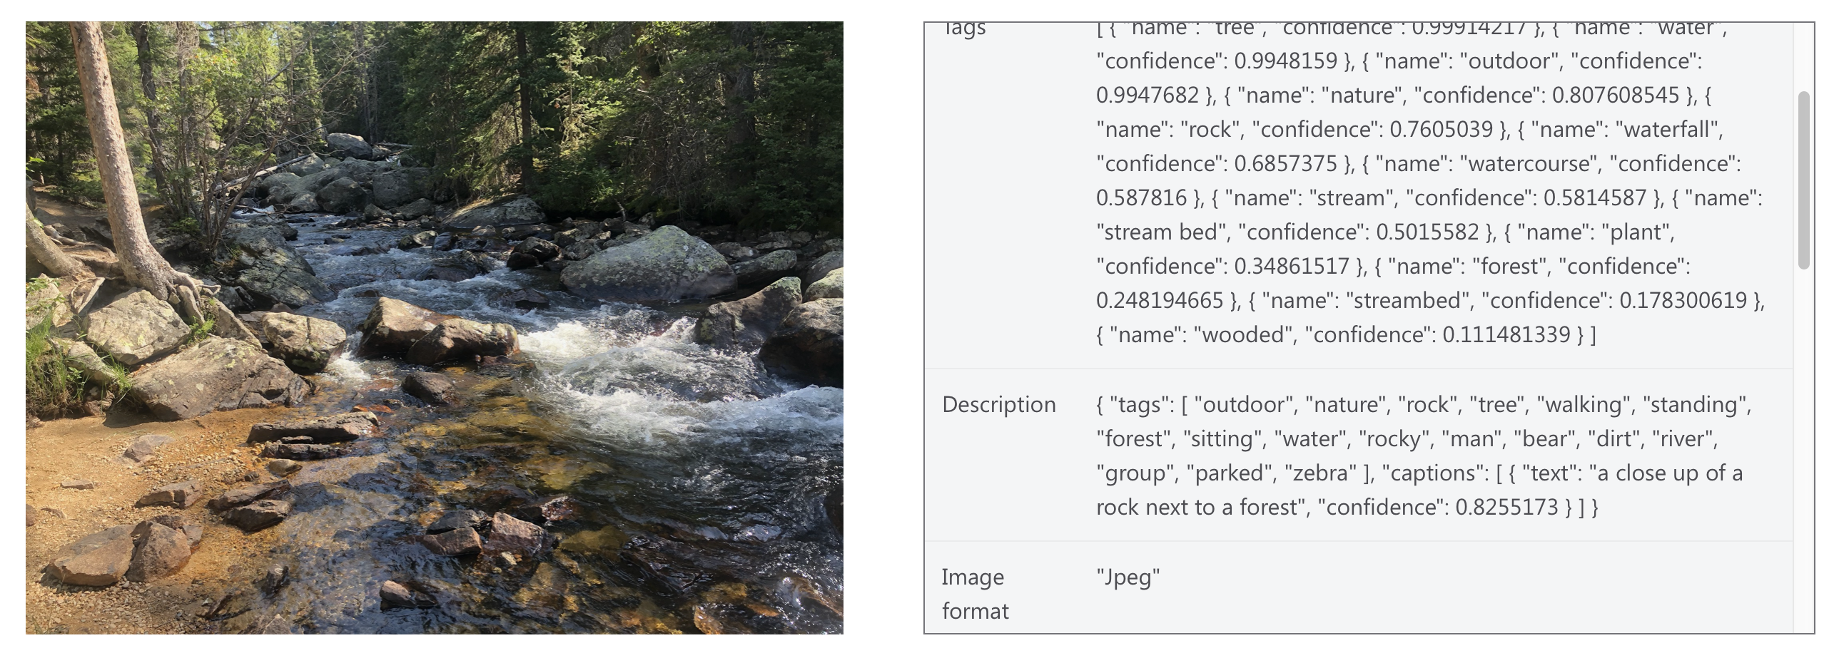
Get text description of a picture

Slide 43
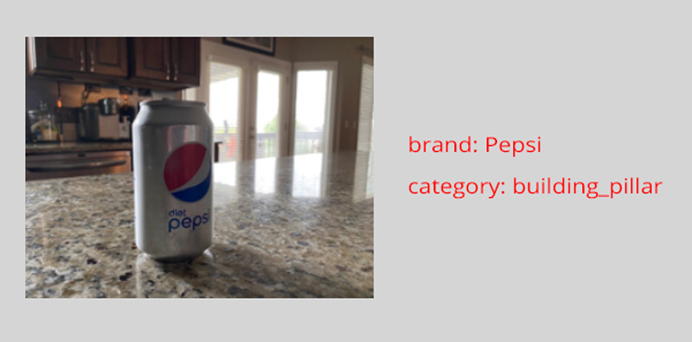
Brand Recognition

Slide 44
McRib

Slide 45
Thank You
Chad Michel
@chadmichel
cmichel@dontpaniclabs.com https://www.linkedin.com/in/chadmichel/

